Slide 1
An independent assessment of the voluntary national review reports submitted to the High
Level Political Forum in 2018
Shannon Kindornay, Adjunct Research Professor, NPSIA

Slide 2
A review of emerging best practice
Civil society initiative
Approach
46 VNRs
Governance and institutions, policies and means of implementation
SG Common Reporting Guidelines

Slide 3


Survey – Who are you? How have you been using the report?

Slide 4
Key Features

Slide 5
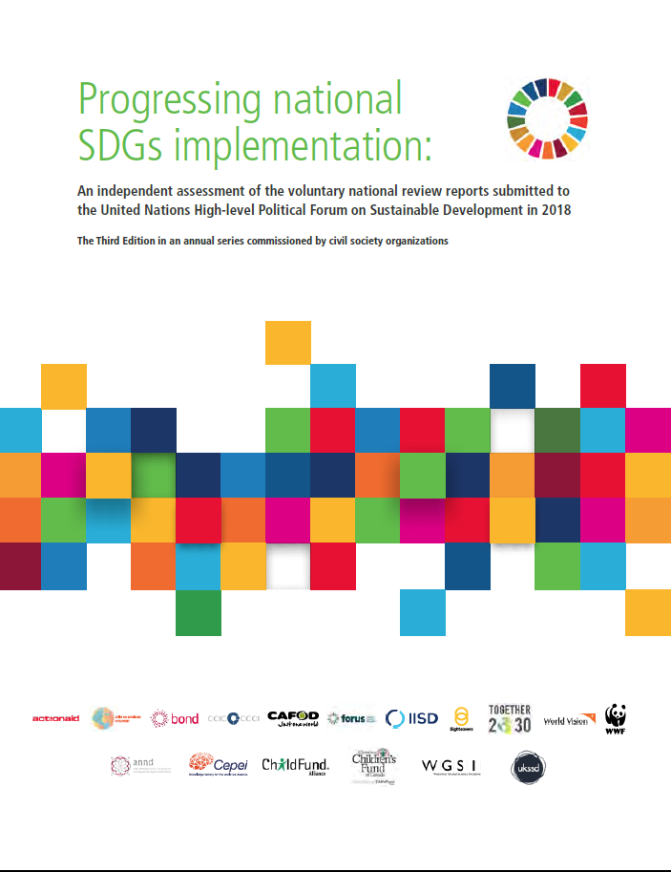
How Progressing National SDGs Implementation can help you…
Understand the current state of 2030 Agenda implementation
Best practice in implementation and for VNRs unpacked
Basis for parallel reporting
Advocacy tool
Reference for progress in individual countries

Slide 6
Key findings
Countries continue to demonstrate progress on foundations for SDGs implementation but progress varies
Transformative elements of the 2030 Agenda still lacking in implementation
Countries still not making the most of the VNR and HLPF
Notes:
In short, the 2018 VNR reports show that the majority of countries have made progress in terms of incorporating the SDGs into national policies, developing institutional mechanisms for implementation, efforts to build partnerships and/or attention to monitoring and evaluation of progress. This is consistent with the assessment of VNR reports in 2017. However, despite the advances being made, country progress on establishing the building blocks for 2030 Agenda implementation - governance structures, institutional arrangements, policies and means of implementation - by our assessment, still varies substantially across countries.
Very few countries are actively engaging in the more transformative elements of the 2030 Agenda, such as incorporating the 2030 Agenda principles into policies and approaches, integrating the three dimensions of sustainable development, localising implementation in line with local needs and establishing effective mechanisms for stakeholder engagement and partnership.
Best practice, challenges, areas countries would like to learn from others- still under reported. Reporting on best practices increased in 2018, however gaps still remain in terms of reporting on lessons learned or areas in which countries would like to learn from others.
Challenges more commonly reported. Only 14 reported where they would like to learn from others.

Slide 7


Key findings – governance and institutions
Inclusion of non-state actors in governance significantly improved
Mechanisms for stakeholder engagement limited
Report offers principles to improve engagement
Notes:
In comparison to 2017, formal inclusion of non-state actors in governance arrangements has shown a marked improvement, shifting from a commitment to engage non-state actors, to now actually including them. This marks a small shift towards a more whole-of-society approach to 2030 Agenda implementation
While half of the countries examined (26) consulted with stakeholders around setting national priorities, and almost all (43) engaged groups around the development of their VNR, there are still relatively few examples of formal processes and mechanisms that have been established to allow for more widespread and regular engagement with stakeholders outside of governance mechanisms.

Slide 8
Key findings – governance and institutions
Engagement principles
Timely
Sufficient notice, relevant time frames
Open
Equal opportunities for access, effective models
Transparent
Process and purpose clear
Informed
Preparatory documents and follow-up provided
Iterative
Engagement is ongoing
Notes:
Principles- timely (sufficient notice and relevant time frames); open (equal opportunity for access and use effective models); transparent (communicate a clear process and purpose with feedback to participants); informed (preparatory and follow-up docs, including how inputs considered); iterative – ongoing process -

Slide 9



Key findings – Policies
Most countries examined data and/or policies to identify gaps and set baselines, though less than in 2017
Continued focus on the SDGs, rather than the broader principles of the 2030 Agenda
Inclusion of culture as part of national priorities
Notes:
Baseline
Most countries (32 of 46, or 69.5%) noted that they carried out some kind of assessment of the SDGs (or some SDGs), or plan to carry out an assessment. This is down from 2017, in which the review of 45 VNR reporting countries showed that 38 countries had either prepared an assessment (33 countries) or planned to carry one out (5 countries). In 2016, this figure was ten of 16 (or 62.5%) countries examined. The European Union has resisted developing a gap analysis for quite some time but has recently expressed its intention to develop a “distance analysis” to identify how far the current policy reality is from the SDG target.
Principles
As was the case in 2017, VNR reporting for 2018 shows that countries tend to focus on the SDGs rather than the broader 2030 Agenda and its transformational principles. While most countries refer to leaving no one behind (41), substantially fewer refer to inter-generational responsibility (17) and universality (16), and even less to human rights-based approaches (six) and planetary boundaries (three).
Culture
Three years after the adoption of the 2030 Agenda, the majority of 2018 VNRs – 35 of 46 – show that national priorities have been selected (34 of 45 countries reviewed in 2017 had selected national priorities). For the 34 countries that provided information on their priorities for 2030 Agenda implementation, the most commonly cited priorities include those related to social outcomes (32) and the economy (30). While the 2017 VNR reports did not show culture as a priority area overall, in 2018, six countries – Ecuador, Hungary, Latvia, Saudi Arabia, the State of Palestine, and the United Arab Emirates – noted culture or issues related to national identify as among their priorities for 2030 Agenda implementation. Notwithstanding the best practice spotlight above that shows Romania has prioritised culture in 2030 Agenda implementation, the country does not actually list its national priorities in its VNR report, and as such, is not included here.

Slide 10

Key findings – Policies
Marked improvement in reporting on all SDGs
Continued limited reference to linkages between dimensions of sustainable development
Notes:
Improvement on reporting
In 2017, 11 of the 45 countries examined reported on all SDGs whereas this figure was 28 countries for 2018. Three (3) countries, versus eight in 2017, reported only on the HLPF theme goals. Eight (8) countries reported on a limited set of country selected SDGs. In 2017, 19 of 45 countries took this approach. Seven (7) countries, the same as in 2017, did not prepare a goal-by-goal analysis, but rather presented progress through a thematic discussion with references to individual goals.
Linkages
29 countries referred to all dimensions equally. In the goal-by-goal analysis, 17 (of 46) countries made references to applicable social, economic and environmental linkages between goal areas. However, more than half of the countries reporting in 2018, or 25 countries, made limited reference to linkages between dimensions, tending to take a silo approach in their goal-by-goal analysis. These findings represent a backsliding in comparison to 2017. In 2017, 22 of 45 countries made appropriate references to linkages while only 19 provide limited references.

Slide 11



Key findings – Means of implementation
Improved reporting on means of implementation
Insufficient reporting on LNOB; unclear how efforts to LNOB have changed policy and practice
Localisation still requires more effort
Notes:
Improved reporting on the means of implementation – notably international public finance, trade, technology and systemic issues.
Limited reporting on leaving no one behind despite the inclusion of this component in the Secretary General’s voluntary common reporting guidelines. There is a need for countries to examine the extent to which policies and programmes are addressing the needs of those left behind first.
The status of local implementation efforts, as highlighted by the 2018 VNR reports, suggests that much more work is needed to promote localisation. Refer to Figure 16 (following slide).

Slide 12
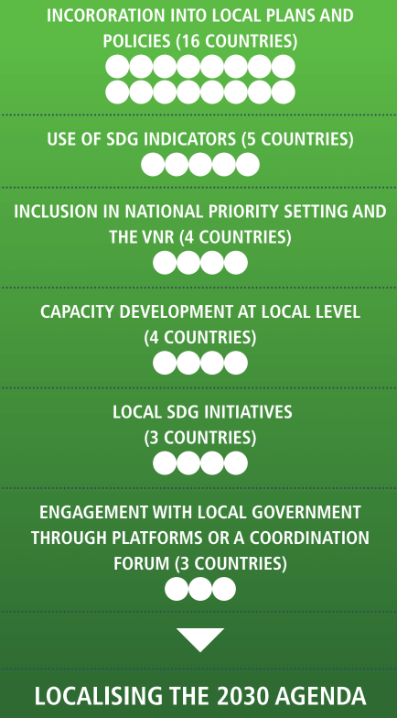
Key findings – Means of implementation
Localisation efforts

Slide 13


Key findings – Means of implementation
Marked improvement in reporting on partnership
Limited commitment to regular reporting on implementation
Notes:
Marked improvement in reporting on contributions from civil society, parliamentarians, the private sector and academia. However, only a handful of VNR reports still included contributions from non-state actors and local governments throughout.
A limited number of countries committed to regular reporting on implementation. Through their VNR report, some countries, including two who have reported previously, signalled progress against targets.

Slide 14
Key findings – Means of implementation
Egypt

Slide 15
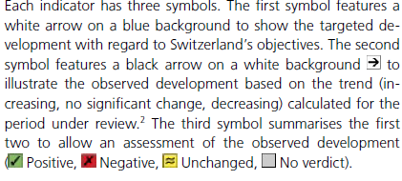
Key findings – Means of implementation
Switzerland

Slide 16
Reporting according to UN guidelines
70% of reporting countries include all elements of the common reporting guidelines
Exceptions LNOB, structural issues and statistical annex
Reports not structured according to guidelines
Notes:
Similar to 2017, many of the VNR reports are not structured according to the outline in the guidelines though they capture most elements. This can hinder comparison of shared challenges and good practices.
The majority of countries include most elements of the voluntary common reporting guidelines in their VNR reports. All elements of the guidelines were included by at least 70% of reporting countries, with the exceptions of leaving no one behind, structural issues and the annexes.
Despite these missing elements, VNR reports still tend to be very long and in some cases unnecessarily detailed. Repetition was identified as a key issue in the 2017 review of VNR reports, however this was less of an issue for the 2018 VNR reports.

Slide 17
Progressing National SDGs Implementation
Executive Summary - sh.ccic.ca/ES-EN
ES and Main Report – sh.ccic.ca/ES-Main
Full Report (ES, Main, Annex) - sh.ccic.ca/FullReport
Annexes – sh.ccic.ca/Annexes
Sommaire (FR) - sh.ccic.ca/ES-FR
Resumen ejecutivo (ES) - sh.ccic.ca/ES-ES

Slide 18
Thank you!
Questions?

